Slide 1
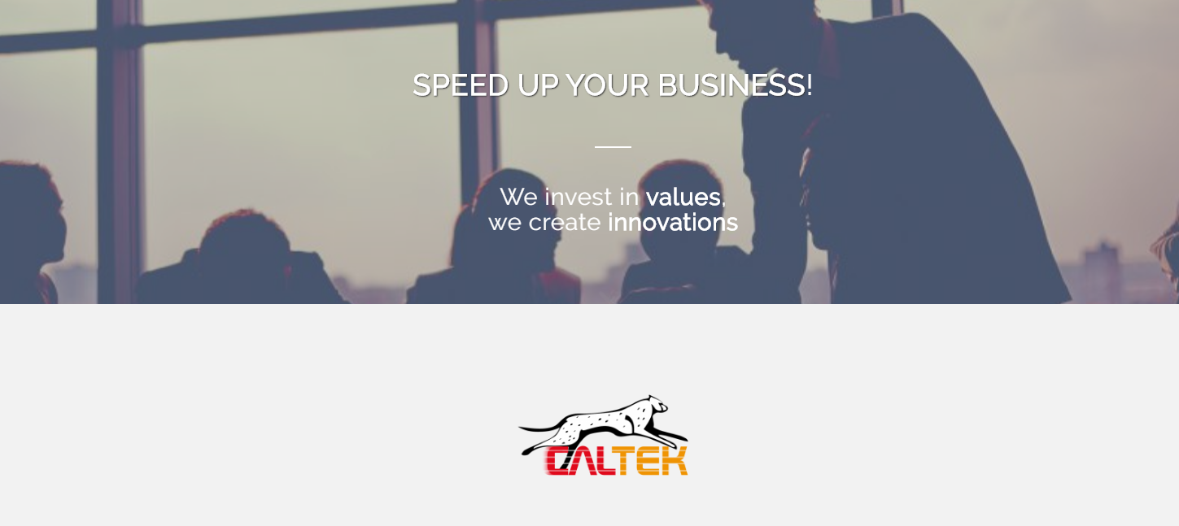
www.cal-tek.eu

Slide 2
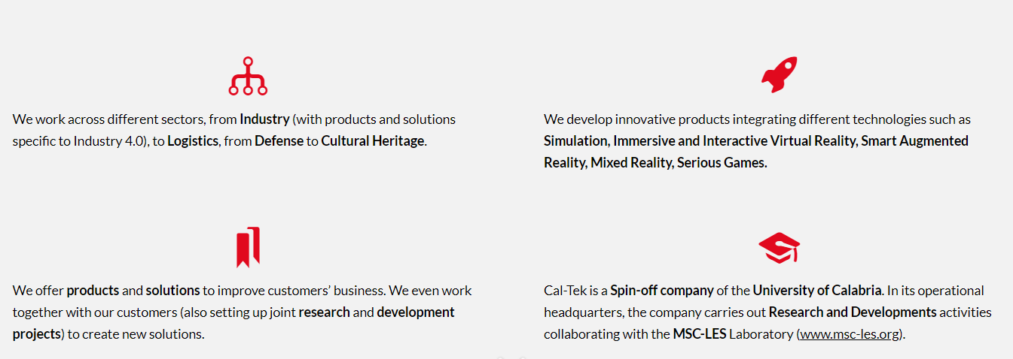
Who we are
Commercial in Confidence

Slide 3
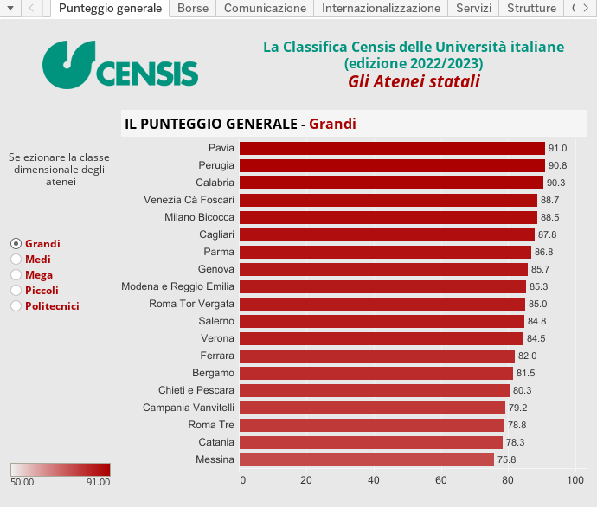
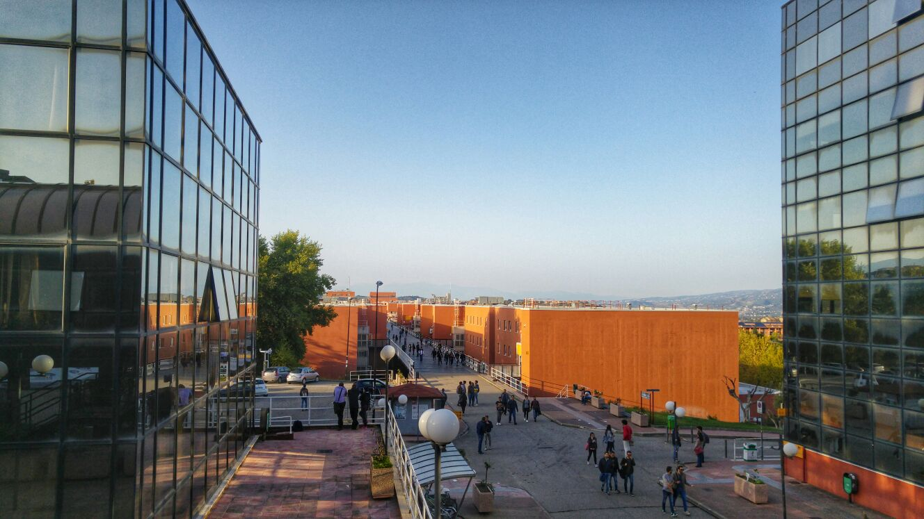
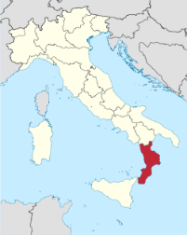
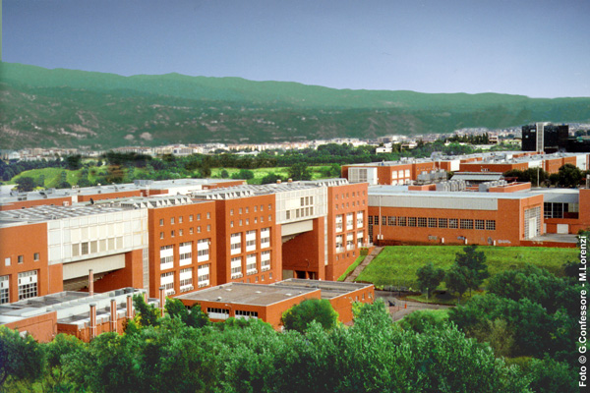

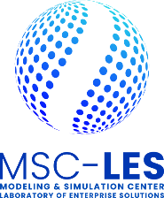
Where we are
Commercial in Confidence
Our main headquarter is located within the University of Calabria
Currently, 2° ranked among the Large Universities in Italy

Slide 4
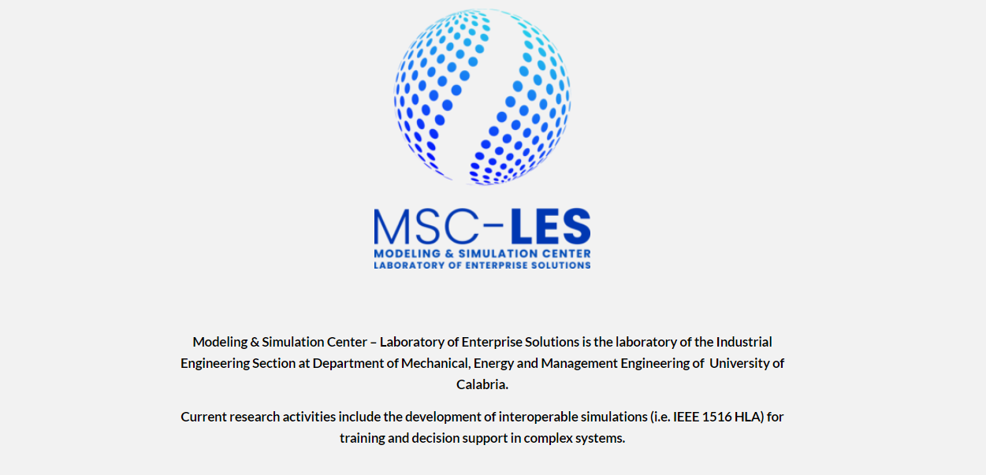
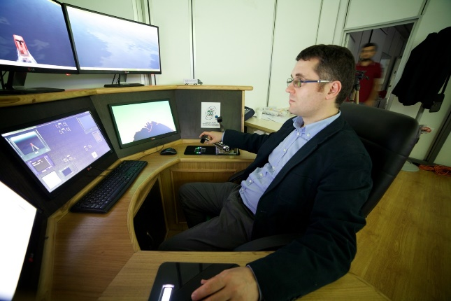
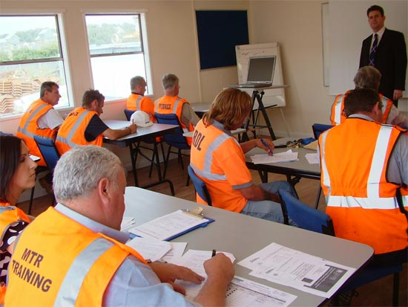
Our University Lab
Commercial in Confidence
www.msc-les.org

Slide 5
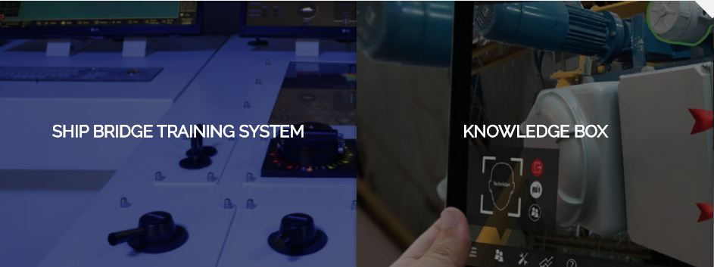
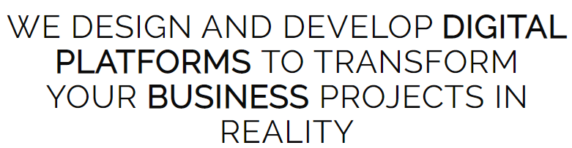
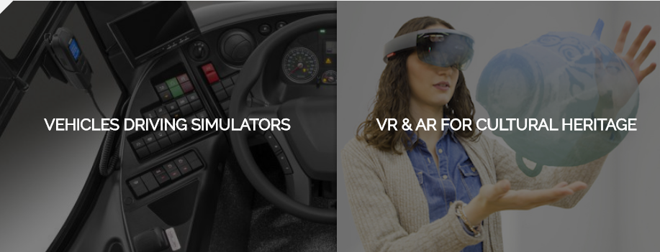
AI and others Innovative Solutions
Commercial in Confidence
Some examples of solutions where AI can provide benefits

Slide 6
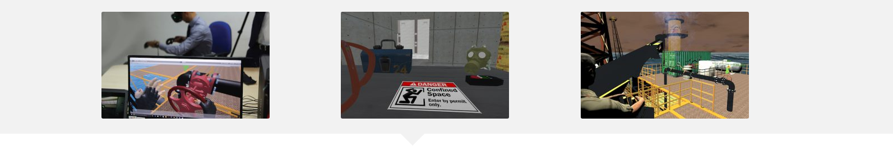
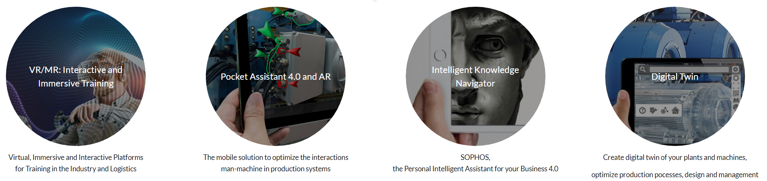
AI and others Innovative Solutions
Commercial in Confidence

Slide 7
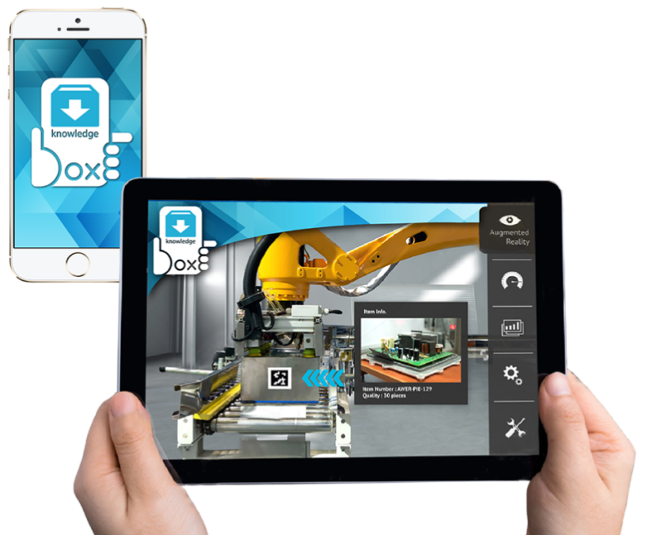
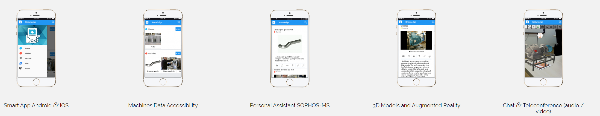
KNOWLEDGE BOX
Commercial in Confidence
Knowledge Box MS (Manufacturing Systems) is an innovative AI-driven tool ready to solve the company needs, improving operators’ skills in human-machine interactions within an Industry 4.0 content
Information systems and devices always connected to have a fast, intelligent access to Augmented Reality contents related to maintenance, safety, security, training and troubleshooting.
Other features
Manuals, 3D construction models, security norms, standard maintenance plans, etc.
Marker-based, marker-less & location-based Augmented Reality
Fast customization of the Digital Twin
Multi-language system
Integration with simulation models for optimization purposes
Multi-platform architecture (Android, iOS)
IoT based Machine Data Accessibility
Intuitive access to information (e.g. photos, videos, text, chat, video-conference)
Interactive 3D Virtual Reality and AR Content

Slide 8
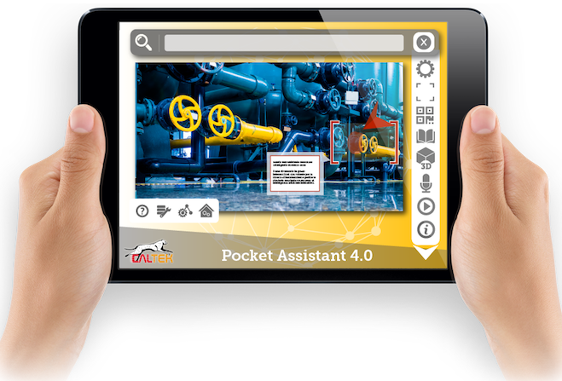
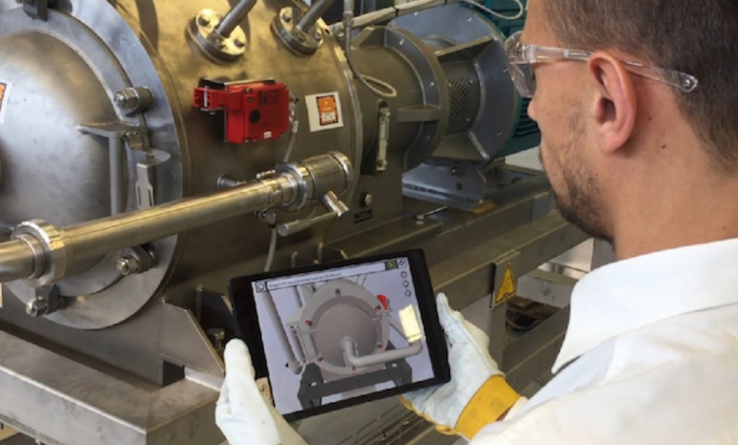
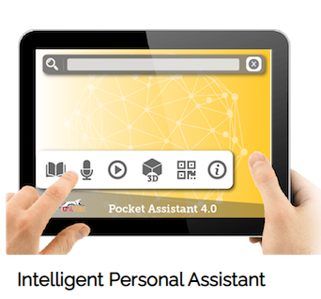
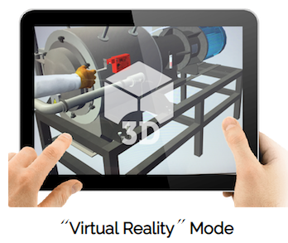
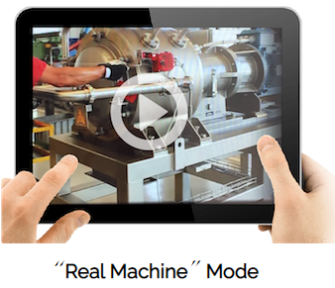
POCKET ASSISTANT 4.0
Commercial in Confidence
Human-in-the-Loop (HIL) Training and Support in the Smart Factory with Pocket Assistant 4.0
Mission: provide shop floor operators (even inexperienced) with AR content on tasks/ procedures execution and intuitive knowledge fruition to increase learning effectiveness, speed up operations and minimize errors and accidents
Functionalities
make available knowledge resources (e.g. manuals, videos, 3D models, guided procedures) usually not directly available at the workplace
be a consultation tool for operators to get easy and fast access to information and contents through AR and a digital intelligent vocal-based assistant
be an immersive and absorbing training environment on new and/or complex procedures
be a tool for workplace safety enhancement

Slide 9
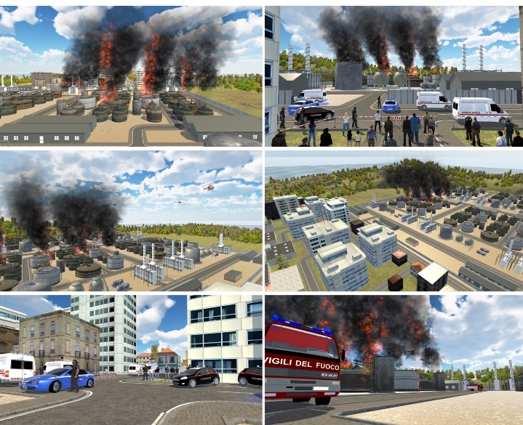
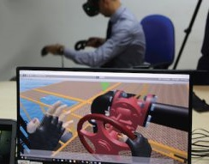
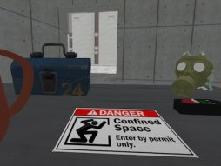
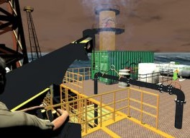
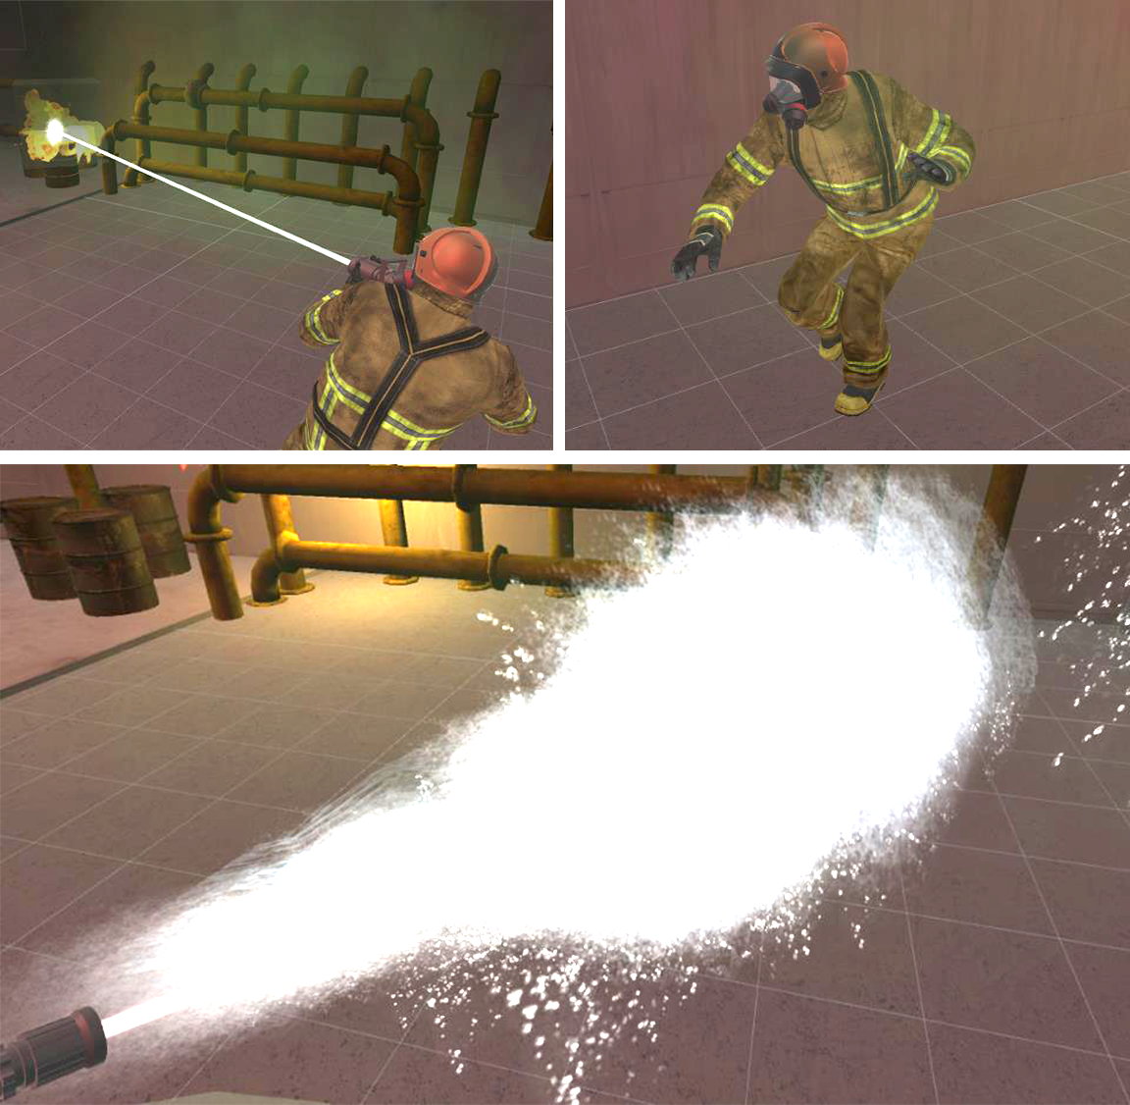
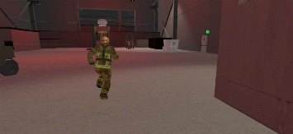
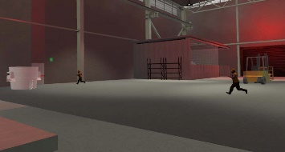
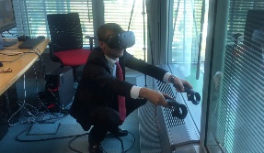
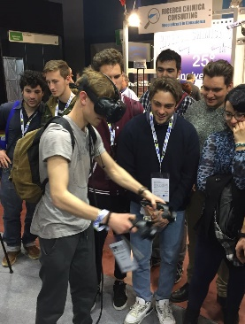
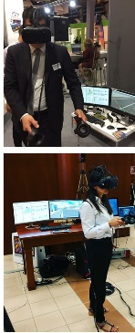
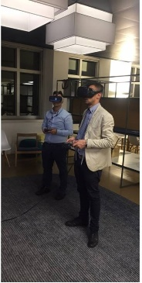
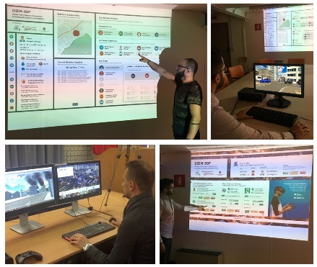
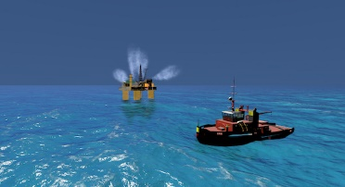
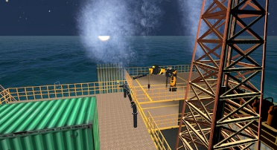
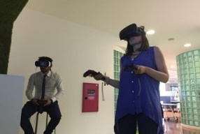
Virtual, Augmented and Extended Reality
Commercial in Confidence
Immersive Interactive Solutions for Training
Our solutions, based on simulation, are developed as Serious Games where operators are immersed in Virtual Reality or Mixed Reality environments through viewers and devices with a meaningful impact on operators’ learning curves.
AI can be used to create realistic scenarios and realistic behavior of the simulation
Fire fighting in industrial facilities
Hazardous operations in confined spaces
Operations in critical infrastructures (offshore rigs)

Slide 10
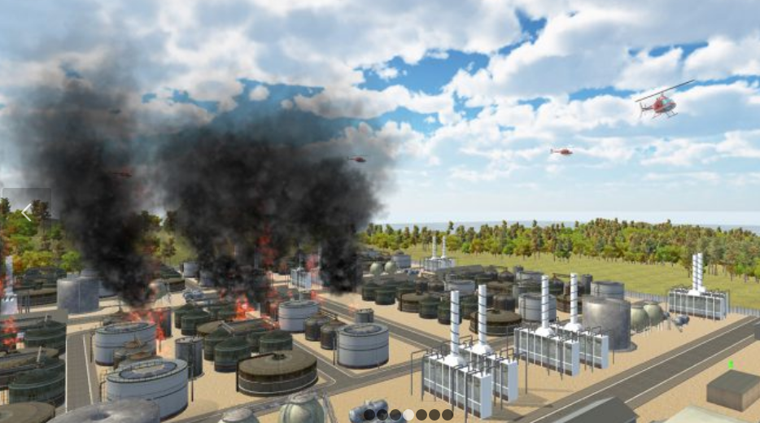
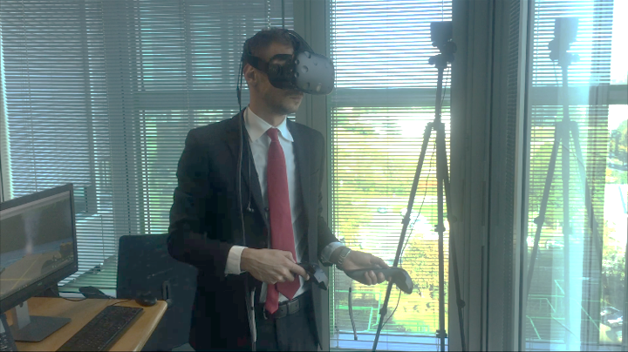
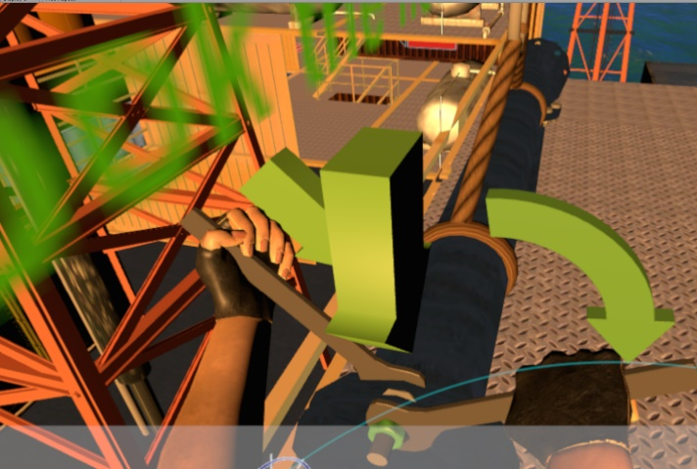
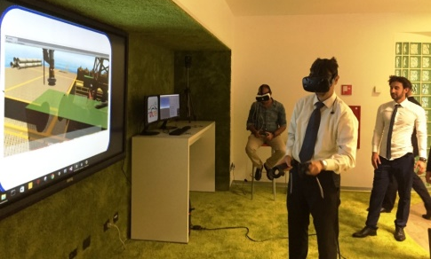
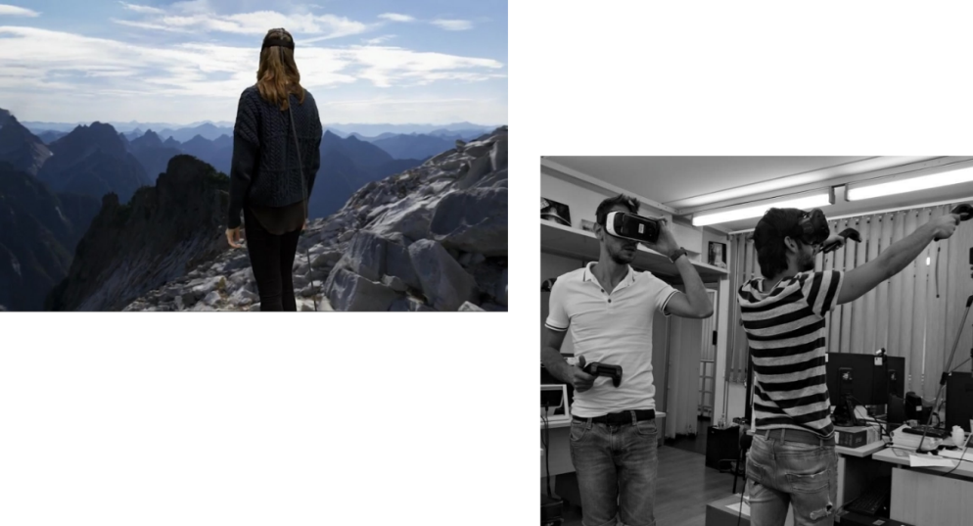
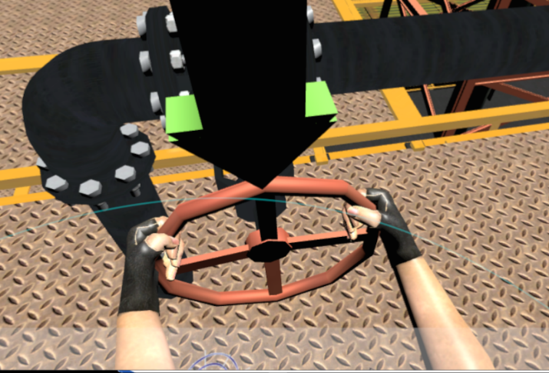
Virtual, Augmented, Extended Reality & AI
Commercial in Confidence

Slide 11
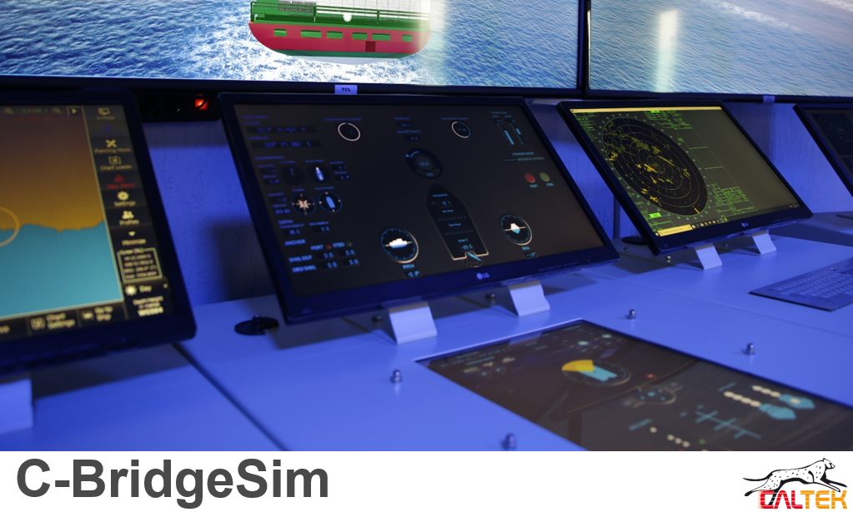
Commercial in Confidence

Slide 12
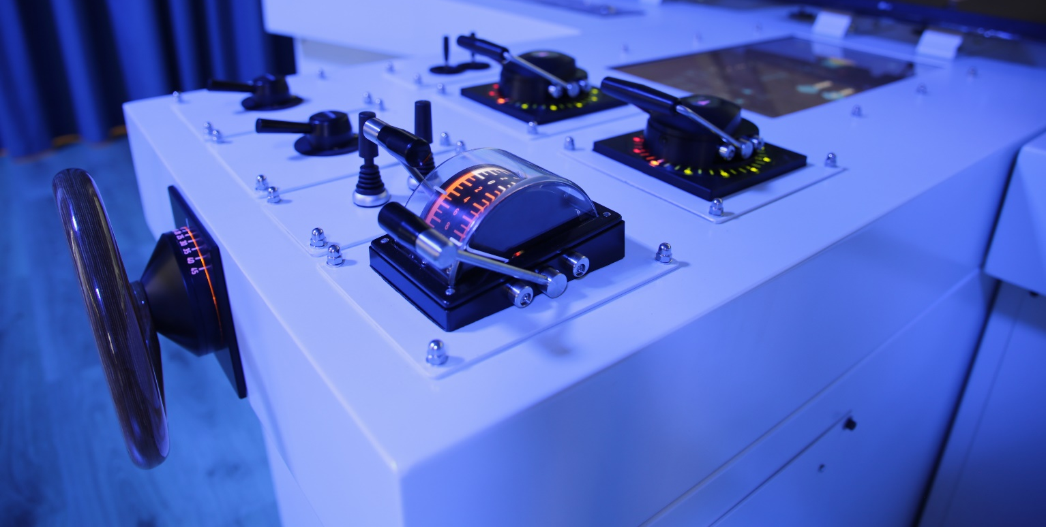
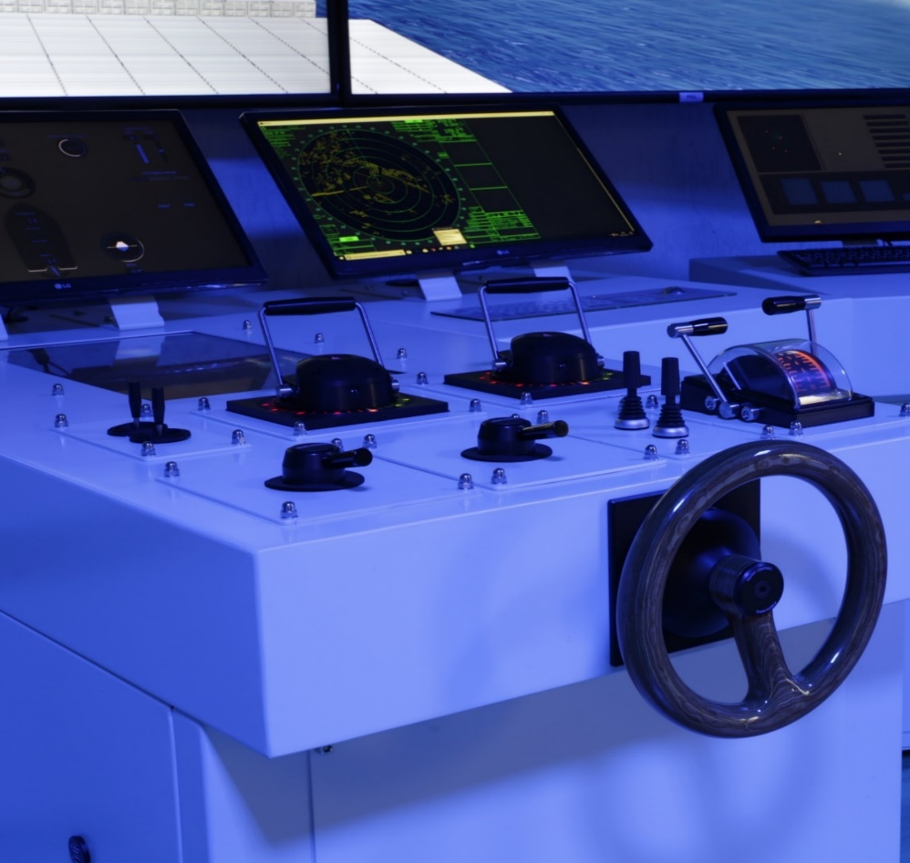
Seamless Augment Trainees Skills & Capabilities
An advanced training experience based on STCW requirements
Commercial in Confidence
C-BridgeSim is a Bridge Simulator certified by RINA as compliant with the requirements of the current Convention on Standards of Training, Certification and Watchkeeping for Seafarers (STCW) in terms of navigation training, on-board guarding, radar with ARPA functions, ECDIS and radio communications.
The Ship Bridge Simulator is characterized by a modular and flexible architecture in terms of future expansions (e.g. addition of new student stations, addition of new training scenarios, etc.).

Slide 13
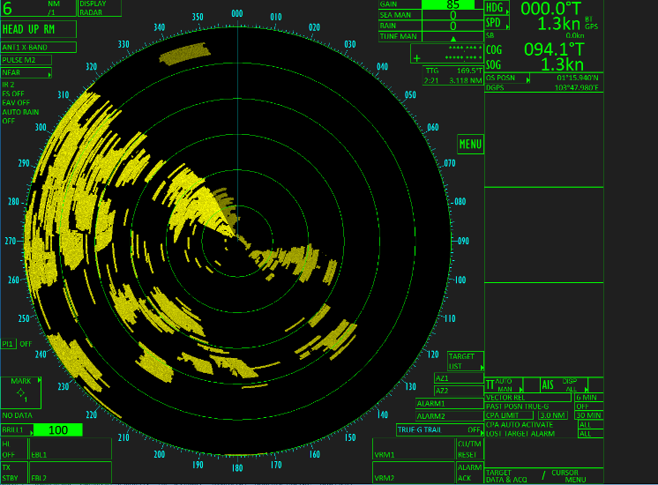
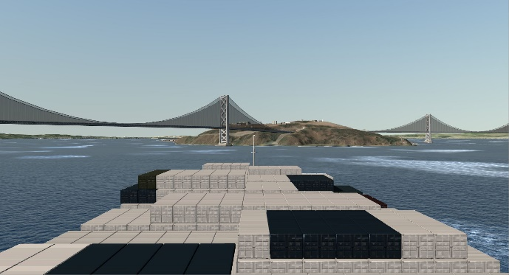
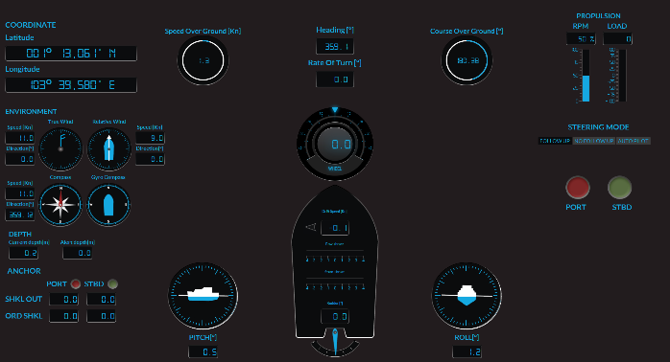
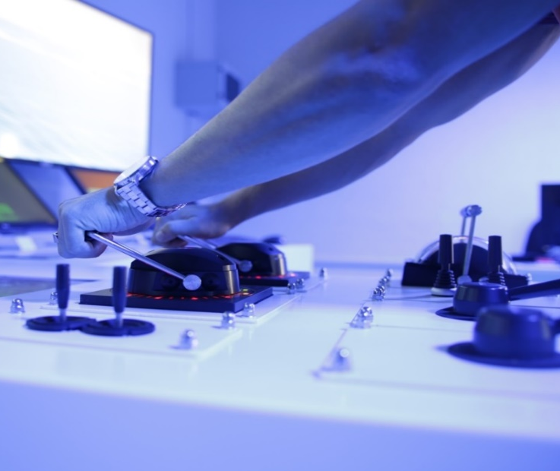

Simulating Complex Scenarios thanks to AI
Complex Environments like in the real world
Commercial in Confidence
Full Picture and beyond
Use AI to create realistic training scenarios
Use AI to control the behavior of target ships
Use AI to create realistic communications among ships
BENEFITS
Estimate the potential risk related to the evolution of situation.
Operate easily and in a coordinate way with other people involved in the simulation through cooperative training.
Define the action to undertake considering also the procedural aspects in a dynamic scenario evolution.
Feel the sensation to be physically, visually and emotionally immersed in the training scenario thanks to realistic virtual environments, procedures, interactions and high quality audio.

Slide 14










Where Research & Development make the Difference
Where many AI researchers and scientists are involved!
Commercial in Confidence
CAL-TEK solutions are developed in cooperation with University of Calabria (where CAL-TEK is a spin off Company) and in cooperation with other worldwide Universities.
With more than 250 scientific articles published on International Journals and International Conferences, our company brings the results of Research & Development activities within the products and the solutions offered to Customers. Our company continuously works to advance the State of the Art in the Simulation domain by integrating new enabling methodologies and technologies such as Virtual Immersive Reality, Augmented/Mixed Reality, Artificial Intelligence and many others.
Our Publications
(http://www.msc-les.org/en/research-and-expertise/)
Our Conferences
The I3M Multi-Conference, www.msc-les.org/i3m2024
The ISM Conference, www-msc-les.org/ism2024
Our Scientific Db
https://www.cal-tek.eu/proceedings/

Slide 15

Commercial in Confidence
We invest in values, we create innovation
Speed up your business!
Francesco Longo, Ph.D.
CAL-TEK S.r.l.
f.longo@cal-tek.eu
Modeling & Simulation Center – Laboratory of Enterprise Solutions (MSC-LES)
Department of Mechanical, Energy and Management Engineering (DIMEG) | University of Calabria
f.longo@unical.it

